Slide 1

BLOOD & BLOOD PRODUCTS USES
Dr. NITHYA.R

Slide 2
OUTLINE
Indications for transfusion
Adverse effects of transfusion
Massive transfusion
Transfusion checklist
Minimize the need for transfusion
Alternatives to transfusion
Safety of blood

Slide 3
Effectiveness of blood transfusion
Appropriate use of blood & blood products
Safe
Accessible at reasonable cost
Adequate to meet the needs

Slide 4
Before transfusion
Is there any need for transfusion?
Indication of transfusion…?
Ways to minimize transfusion…?

Slide 5
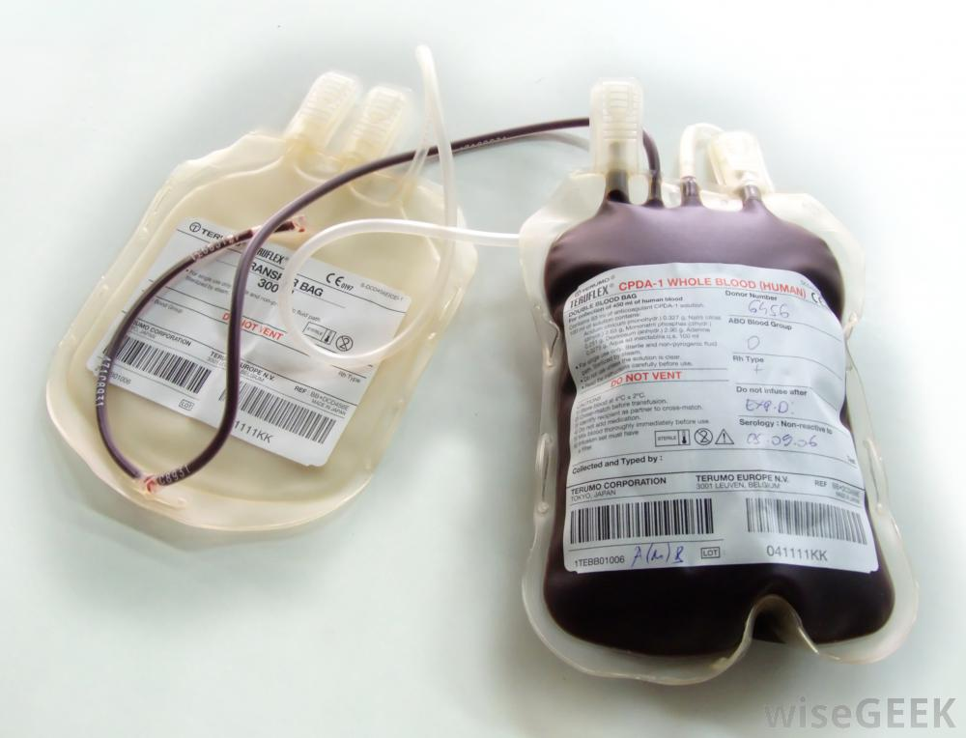
INDICATIONS OF TRANSFUSION

Slide 6
INDICATIONS
Blood loss
Acute/ chronic
External/ Internal
Internal – Traumatic/ Non - traumatic (ruptured ectopic, APH, rupture uterus)
Red cell destruction (sepsis, HIV, Malaria)
Hemolysis ( DIC, Sepsis, Malaria)
Cardiorespiratory decompensation
Anaemia
Anticipated need for blood (surgery)

Slide 7
In Obstetrics,
Question of transfusion… ?
Chronic Anaemia
Major Obstetric hemorrhage (Need for atleast 4 U of blood)¹
Notes:
2 main causes of maternal morbidity & mortality – condition that often requires transfusion

Slide 8
ANAEMIA - FACTORS
Haemoglobin level.
Stage of pregnancy
Evidence of cardiac failure
Presence of infection: e.g. pneumonia, malaria
Obstetric history
Anticipated delivery:
— Vaginal
— Caesarean section
Prevention of Anaemia
Adequate nutrition
Health Education
Personal Hygiene
Prophylactic administration of Iron & Folic acid

Slide 9
TRANSFUSION GUIDELINES - CHRONIC ANAEMIA IN PREGNANCY*
Duration of pregnancy less than 36 weeks
Haemoglobin 5.0 g/dl or below, even without clinical signs of cardiac failure or hypoxia
Haemoglobin between 5.0 and 7.0 g/dl and in the presence of the following conditions:
Established or incipient cardiac failure or clinical evidence of hypoxia
Pneumonia or any other serious bacterial infection
Malaria
Pre-existing heart disease, not causally related to the anaemia
(* WHO – 2009)

Slide 10
TRANSFUSION GUIDELINES - CHRONIC ANAEMIA IN PREGNANCY*
Duration of pregnancy 36 weeks or more
Haemoglobin 6.0 g/dl or below
Haemoglobin between 6.0 g/dl and 8.0 g/dl and in the presence of the
following conditions:
Established or incipient cardiac failure or clinical evidence of hypoxia
Pneumonia or any other serious bacterial infection
Malaria
Pre-existing heart disease, not causally related to the anaemia
(* WHO – 2009)

Slide 11
TRANSFUSION GUIDELINES - CHRONIC ANAEMIA IN PREGNANCY*
Elective Caesarean section
When elective Caesarean section is planned and there is a history of:
Antepartum haemorrhage (APH)
Postpartum haemorrhage (PPH)
Previous Caesarean section
Haemoglobin between 8.0 and 10.0 g/dl: establish/confirm blood group and save freshly taken serum for crossmatching
2) Haemoglobin less than 8.0 g/dl: two units of blood should be crossmatched and available (* WHO – 2009)

Slide 12
MAJOR OBSTETRIC HEMORRHAGE
Sl. No. | CAUSES | CONDITIONS
1. | Fetal loss in pregnancy | Incomplete abortion Septic abortion
2. | Ectopic pregnancy | Tubal, Abdominal
3. | Antepartum Hemorrhage/ Rupture uterus | Placenta praevia, Abruptio placentae Vasa praevia Incidental hemorrhage from cervix or vagina
4. | Traumatic lesions | Episiotomy Laceration of perineum or vagina Laceration of cervix

Slide 13
MAJOR OBSTETRIC HEMORRHAGE
Sl. No. | CAUSES | CONDITIONS
5. | Post partum Hemorrhage (Primary) | Uterine atony Retained products of conception Abnormally adherent placenta (placenta accreta) Clotting defects Acute uterine inversion
6. | Post partum Hemorrhage (secondary) | Puerperal sepsis Retained products of conception Tissue damage following obstructed labour
7. | DIC | Intrauterine death, Amniotic fluid embolism Sepsis, Pre-eclampsia, Abruptio placentae Retained products of conception Induced abortion, Acute fatty liver
Notes:
Primary- within 24 hrs of delivery, Secondary – after 24 hrs within 6 weeks od delivery

Slide 14
Classification of Acute Blood loss in Obstetrics (ACS -2004)
Grade | Vol. of acute blood loss (ml) | % of blood loss | Signs & symptoms | Treatment
I | 600-1200 | 10-20 | Minimal tachycardia | Replacement with crystalloids
II | 1200-1800 | 20-25 | ↑ Pulse rate, ↑ resp. rate, narrowing of pulse pressure | May require blood transfusion but can be stabilized by crystalloids
III | 1800-2400 | 30-40 | ↓ in BP, significant tachycardia | Blood transfusion is usually needed
IV | >2400 | >40 | Profound shock | Massive Transfusion Protocol

Slide 15
RED CELLS TRANSFUSION
Acute blood loss of any amount with clinical evidence of
inadequate oxygen carrying capacity.
Hb of < 7g/dl, if not due to treatable cause
Symptomatic anaemia regardless of Hb levels
A major blood letting operation and Hb of < 10g/dl
(Rossi’s Principles of Transfusion Medicine,2009)

Slide 16
CAUSES OF THROMBOCYTOPENIA IN PREGNANCY
Spurious thrombocytopenia
Gestational thrombocytopenia
Preeclampsia and HELLP
Thrombotic microangiopathies (HELLP, TTP, HUS)
Disseminated intravascular coagulation
Idiopathic/immune thrombocytopenic purpura
Anti phospholipid antibody syndrome
Congenital thrombocytopenia / platelet function disorders.
Notes:
Spurious – lab / technical error/edta agg. Gestational thrombocytopenia – 80,000 to 1,50000 diagnosis of exclusion, no e/o ITP ,APS. More prone to develop HELLP.

Slide 17
PLATELET TRANSFUSION
During pregnancy, thrombocytopenia result from enhanced platelet phagocytosis in ITP or consumption in TMA, both disorders in which platelet transfusions are reserved for therapeutic indications
Reduced marrow platelet production is rare
Platelet < 20,000 without bleeding; < 50,000 with bleeding needs to be transfused (WHO).
Guidelines recommend a platelet count above 50,000/μL for delivery and 80,000/μL for cesarean section².

Slide 18
ORDERING SCHEDULE
EMERGENCY (blood needed in ≤ 1 hr)
Possible need for blood
Definitive need for blood
Assess the Need for Transfusion
Urgent request of ABO & RhD compatible units (‘O’ Group)
Request group, antibody screen and hold
Request ABO & RhD compatible units be available at stated time

Slide 19
ADVERSE EFFECTS OF TRANSFUSION

Slide 20
ADVERSE EFFECTS
ACUTE COMPLICATIONS
(within 24 hrs of transfusion)
DELAYED COMPLICATIONS
(After 5 – 10 days of transfusion)

Slide 21
ACUTE COMPLICATIONS
DELAYED COMPLICATIONS
Acute transfusion reaction
Acute intravascular hemolysis
Bacterial contamination & Septic shock
Anaphylactic reaction
Transfusion Associated Acute Lung Injury (TRALI)
Hemolytic transfusion reaction
Post – transfusion purpura
Graft versus host disease
Iron overload
Transfusion – transmissible infections
Notes:
Hiv, HTLV, hepatitis B & C, malaria, chagas, syphilis, CMV, Parvo virus, EBV, toxoplasma, lymes disease

Slide 22
TRANSFUSION REACTIONS

Slide 23
Guidelines for the recognition and management of acute transfusion reactions (WHO-2009)
Category 1 (mild reactions)
Category 2 (moderately severe reactions)
Category 3 (life– threatening reactions)

Slide 24
CATEGORY - 1
CHARACTERS | FEATURES & MANAGEMENT
Symptoms | Itching
Signs | Localized cutaneous reactions (rashes, urticarial)
Possible cause | Mild hypersensitivity
Treatment | Slow the transfusion. Administer antihistamine IM (chlorpheniramine 0.1mg/kg) If no clinical improvement within 30 minutes or if signs and symptoms worsen, treat as Category 2.

Slide 25
CATEGORY - 2
CHARACTERS | FEATURES
Symptoms | Anxiety, Pruritus, Palpitations, Mild dyspnea, Headache
Signs | Flushing, Urticaria, Rigors, Fever, Restlessness, Tachycardia
Possible causes | Hypersensitivity (moderate–severe) Febrile non-haemolytic transfusion reactions: — Antibodies to white blood cells, platelets — Antibodies to proteins, including IgA Possible contamination with pyrogens and/or bacteria

Slide 26
CATEGORY 2 - MANAGEMENT
STOP THE TRANSFUSION. Keep IV line open with normal saline.
NOTIFY the doctors and the blood bank immediately.
Send blood unit with infusion set, blood samples with appropriate request form to blood bank for LABORATORY INVESTIGATIONS.
Administer ANTIHISTAMINE AND ANTIPYRETIC. Avoid aspirin in thrombocytopenic patients.
Give IV corticosteroids and bronchodilators; if there are anaphylactoid features.
Collect urine for next 24 hours for evidence of haemolysis and send to laboratory.
If clinical improvement, restart transfusion slowly with new blood unit and observe carefully.
If no clinical improvement within 15 minutes or if signs and symptoms worsen, treat as Category 3.

Slide 27
CATEGORY - 3
CHARACTERS | FEATURES
Symptoms | Anxiety, Chest pain, Pain near infusion site, Headache, Respiratory distress/ shortness of breath Loin/back pain
Signs | Rigors, Fever, Restlessness, Tachycardia (rise of ≥20% in HR) Hypotension (fall of ≥20% in systolic BP) Haemoglobinuria (red urine) Unexplained bleeding (DIC)
Possible causes | Acute intravascular haemolysis Bacterial contamination and septic shock Fluid overload Anaphylaxis Transfusion associated acute lung injury (TRALI)

Slide 28
CATEGORY 3 - MANAGEMENT
STOP THE TRANSFUSION. Replace the infusion set and keep IV line open with NS.
Infuse normal saline (initially 20–30 ml/kg) to maintain systolic BP. Elevate patient’s legs.
Maintain airway and give high flow oxygen by mask.
Give ADRENALINE (as 1:10000 solution) 0.01 mg/kg, slow IV injection.
Give IV corticosteroids and bronchodilators, if there are anaphylactoid features.
Give DIURETIC: e.g. frusemide 1 mg/kg IV or equivalent.
Notify the doctor responsible for patient and blood bank immediately.
Send blood unit with infusion set, fresh urine sample and new blood samples with request form to blood bank for investigations.
Check a fresh urine specimen visually for signs of haemoglobinuria.

Slide 29
Continued…
Start a 24-hour urine collection and record all intake and output. MAINTAIN FLUID BALANCE.
ASSESS FOR BLEEDING from puncture sites or wounds. If there is clinical or laboratory evidence of DIC, give platelets, cryoprecipitate or fresh frozen plasma.
Reassess. If hypotensive: Give further saline 20–30 ml/kg over 5 minutes Give inotrope, if available.
If urine output falling or laboratory evidence of acute renal failure (rising K+, urea, creatinine): Maintain fluid balance accurately Give further frusemide Consider dopamine infusion, if available Seek expert help: the patient may need renal dialysis.
If bacteremia is suspected (rigors, fever, collapse, no evidence of a haemolytic reaction), start broad-spectrum antibiotics IV.

Slide 30
Best way to prevent transfusion reaction
Following “TRANSFUSION CHECKLIST”

Slide 31
TRANSFUSION – CHECK LIST
1) Check the blood bag for compatibility label.
Patient’s name:
Patient’s hosp. no:
Patient’s ward:
Patient’s ABO and RhD group:
Expiry date:
Blood pack no. :
Date of compatibility test:
Blood group of blood pack:
2) Check the blood bag for any discoloration & signs of leakage.
3) Informed Consent from the patient

Slide 32
4) The reason for transfusion.
5) Signature of the prescribing clinician.
6) Pre-transfusion checks of:
Patient’s identity
Compatibility label
7) Signature of the person performing the pre-transfusion identity check.
8) The transfusion:
Type and volume of each product transfused
Unique donation number of each unit transfused
Blood group of each unit transfused
Time at which the transfusion of each unit commenced
Time at which the transfusion of each unit ended
Any transfusion reactions

Slide 33
Monitoring of the patient before, during and after the transfusion
WHEN ?
WHAT ?
Pre – transfusion
Immediately after starting
15 mins after starting
Every hour till the transfusion ends
Post transfusion
General condition
Temperature
Pulse rate
Blood pressure
Respiratory rate
CVS
RS
Urine output

Slide 34
MASSIVE TRANSFUSION

Slide 35
MASSIVE TRANSFUSION
Replacement of blood loss equivalent to or greater than the patient’s
total blood volume in less than 24 hours:
70 ml/kg in adults
80–90 ml/kg in children or infants
Replacement of more than 50% of the blood volume in 3 hours in an adult. (DGHS)
Morbidity & mortality are due to :
Initial trauma leading to hypovolemia, hemorrhagic shock
Tissue and organ damage – large volume being infused in less time

Slide 36
COMPLICATIONS
Metabolic alkalosis
Hyperkalemia
Hypocalcemia
Hypothermia
Citrate toxicity
Depletion of platelets, fibrinogen, coagulation factors
DIC – Most common cause of mortality
ARDS

Slide 37
WAYS TO MINIMIZE THE NEED FOR TRANSFUSION

Slide 38
The prevention or early diagnosis and treatment of anemia
Replenish Iron Stores
The use of intravenous fluid replacement with crystalloids or colloids
Good anaesthetic and surgical management, including:
Use of best anaesthetic and surgical techniques - minimize blood loss during surgery
Stopping anticoagulants and anti-platelet drugs before planned surgery
Salvaging and re-infusing surgical blood losses
Using alternative approaches such as desmopressin, aprotinin or erythropoetin.
Notes:
Correction of anemia using iron / vitamin supplementation, without the need for transfusion
IVF whenever needed esp in cases of acute blood loses. Elevating the surgical field above the level of heart, deliberate hypotension

Slide 39
ALTERNATIVES TO BLOOD TRANSFUSION
Volume expanders
(Replacement Fluids)
Autologous Donation

Slide 40
REPLACEMENT FLUIDS
Replacement fluids are used to replace abnormal losses of blood, plasma or other extracellular fluids by increasing the volume of the vascular compartment
REPLACEMENT FLUIDS
Established Hypovolaemia
(haemorrhagic shock)
Maintenance of Normovolaemia (ongoing fluid losses – surgical blood loss)

Slide 41
REPLACEMENT FLUIDS
First line of treatment for hypovolaemia
Life – saving
Provide some time
to control bleeding
To obtain blood for transfusion
Crystalloids & colloids

Slide 42
Crystalloids
effective iv replacement fluids
Similar concentration to plasma sodium (Normal saline & Ringer lactate)
Colloid solutions
effective replacement fluid
Not superior to crystalloids in resuscitation
albumin, dextran, gelatins & starch solutions
Dextrose – poor replacement fluid (contains no sodium)
Plain water should never be infused intravenously – causes haemolysis
Blood Volume Deficit = 3 Crystalloids = 1 Colloid
Notes:
Crystalloid replacement fluids should be infused in a volume at least three times the volume lost in order to correct hypovolaemia.
Colloid solutions should be infused in a volume equal to the blood volume deficit

Slide 43
FLUIDS | ADVANTAGES | DISADVANTAGES
CRYSTALLOIDS | Few side-effects Low cost Wide availability | Short duration of action May cause oedema Weighty and bulky
COLLOIDS | Longer duration of action Less fluid required to correct hypovolaemia Less weighty and bulky | No evidence that they are more clinically effective Higher cost May interfere with clotting Risk of anaphylactic reactions

Slide 44
AUTOLOGOUS DONATION
Giving a person back his or her own (autologous) blood, reduces the need for transfusions from other donors.
Pre-operative autologous donation is useful in patients with multiple allo-antibodies and patients of rare blood group
Intraoperative cell Salvage* (auto transfusion) is lost blood can be ‘salvaged’ by collecting it with a special machine (Leucocyte depleted filters) and infusing it back into the patient at same time.
Advantages : ↓ the risk of transfusion related infection, transfusion reactions.
Disadvantages : Amniotic Fluid Embolism, Hemolytic disease in future pregnancy
(* NICE Guidelines – 2005)
Notes:
Though not useful in obstetrics, Useful in CTVS & Ortho Surgeries. The risk are due to reinfusing amniotic fluid, Fetal blood cells

Slide 45
BLOOD SAFETY
Well-organized blood transfusion service.
Collection of blood - voluntary non-remunerated donors
Rigorous procedures for donor selection.
The screening for transfusion-transmissible infection
Blood grouping, compatibility testing, component preparation
Proper storage and transportation of blood and blood products.
Reduction in unnecessary transfusions
(appropriate clinical use of blood and blood products,
use of simple alternatives to transfusion, wherever possible)
Notes:
With good quality systems
Collection of blood
HIV, hepatitis, syphilis, chagas, malaria

Slide 46
BLOOD – EXPENSIVE & SCARCE RESOURCE
Unnecessary transfusions
Unnecessary Risks
Shortage of blood products for patients in real need

Slide 47
REFERENCES
Zwart JJ, Richters JM, Ory F, et al. Severe maternal morbidity in the Netherlands during pregnancy, delivery and puerperium: A nationwide population-based study of 371,000 pregrancies. Br J Obstett Gynaecol 2008;115:842–50.
British Committee for Standards in Haematology, General Haematology Task Force. Guidelines for the investigation and management of idiopathic thrombocytopenic purpura in adults, children and in pregnancy. Br J Haematol 2003;120:574-96.
Rossi's Principles of Transfusion Medicine, 4th Edition, Edited by Toby L. Simon, E. L. Snyder, B. G. Solheim, Christopher, P. Stowell, Ronald, G. Strauss and Marian Petrides © 2009 Blackwell Publishing Ltd. ISBN: 978-1-405-17588-3
4) Shock. American College of Surgeons committee on trauma: advanced trauma life support for doctors, vol. 7. Chicago: American College of Surgeons; 2004. p. 69–102.

Slide 48


Slide 49
RESPONSIBILITIES OF CLINICIAN
Correctly complete a blood request form.
Collect the blood sample from the right patient in the right sample tube and correctly label the sample tube.
Order blood in advance, whenever possible.
Provide the blood bank with clear information on:
The products and number of units required
The reason for transfusion
The urgency of the patient’s requirement for transfusion
When and where the blood is required
Who will deliver or collect the blood.

Slide 50
CONTINUED…
Ensure the correct storage before transfusion.
Transfusion Checklist - Documentation (before transfusion).
Safe disposal - blood pack that has been at room temperature for more than 4 hours/ pack that has been opened/ shows any signs of deterioration.
Correctly record transfusions in the patient‘s notes:
Reason for transfusion
Product and volume transfused
Time of transfusion
Monitoring of the patient before, during and after transfusion
Any adverse events
Notes:
Appropriate storage in clinical area, Patient s identity, app. Product,
Safe disposal – discard, return to blood bank

